Slide 1
Recap Session 1

Slide 2

Input/Output
Python programs interact with user by taking input and providing output
Input: Data entered by user during program execution
Output: Information displayed on screen or written to a file by the program

Slide 3
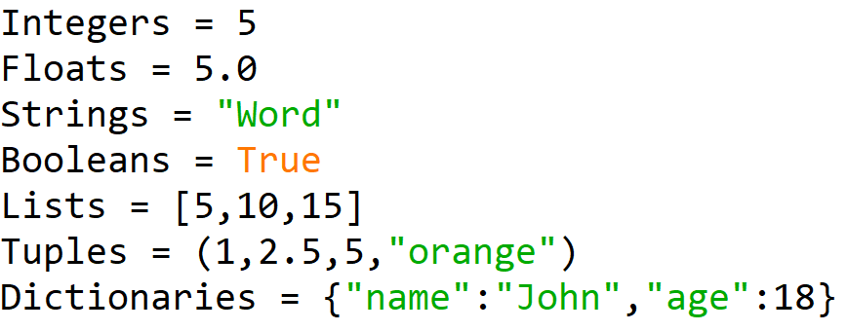
Data Types
Data types define the kind of data a variable can hold
Various in-built data types
Integers
Floats
Strings
Booleans
Lists
Tuples
Dictionaries

Slide 4

Variables
Are named containers that store data
Allow us to refer to data by name instead of actual value
Naming conventions
Start with letter or underscore (_)
Can contain letters, numbers, underscores
Case-sensitive
Declaring
Assign value to variable using assignment operator (=)
Does not require explicit data type declaration

Slide 5
Operators
Perform operations on data
Provide various operators for different purposes
Arithmetic
(+,-,*,/,//,%,**)
Comparison
(==,!=,<,>,<=,>=)
Logical
(and,or,not)
Assignment
(+=,-=,*=,/=,//=,%=,**=)
Order of operations applies when using multiple operators in an expression

